Slide 1
Cloud Based Data Engineering
Approximation and Randomization

Slide 2
Expectation
Let $X$ be a discrete random variable with values $x_{1},x_{2},…, x_{n}.$
$$E\left[X\right]=\sum_{i=1}^{n}{x_{i}⋅P(X=x_{i})}$$
Linearity: ALWAYS, no matter what are the relations between X and Y!
$$E\left[X+Y\right]=E\left[X\right]+E\left[Y\right]$$
$$E\left[cX\right]=cE\left[X\right]$$

Slide 3
Variance
Let $X$ be a discrete random variable with values $x_{1},x_{2},…, x_{n}.$
Variance:
$$V\left[X\right]=E\left[{\left(X−E\left[X\right]\right)}^{2}\right]=E\left[X^{2}\right]−{\left(E\left[X\right]\right)}^{2} \\ V\left[cX\right]=c^{2}V\left[X\right]$$
Independence
Let $X,Y$ be random variables, then $X,Y$ are independent if and only if
$$P\left[X=x_{i},Y=y_{i}\right]=P\left[X=X_{i}\right]⋅P[Y=y_{i}]$$

Slide 4

Probability Tools
Union Bounds: Let $E_{1},E_{2},…, E_{n}$ events, then
$$P\left[E_{1}∪E_{2}∪…∪E_{n}\right]≤P\left[E_{1}\right]+P\left[E_{2}\right]+…+P\left[E_{n}\right]$$
Bernoulli’s inequality:
$$1+x≤e^{x}$$
Sum of arithmetic series:
$$S_{n}=\frac{n}{2}[a_{1}+a_{n}]$$

Slide 5
Hash Tables / Functions
Notation:
U – Universe of all possible keys.
K – Set of keys actually stored in the dictionary.
|K| = n.
When U is very large,
Arrays are not practical.
|K| << |U|.
Use a table of size proportional to |K| – The hash tables.

Slide 6
Hashing
Hash function h: Mapping from U to the slots of a hash table T[0..m–1].
h : U → {0,1,…, m–1}
With arrays, key k maps to slot A[k].
With hash tables, key k maps or “hashes” to slot T[h[k]].
h[k] is the hash value of key k.

Slide 7
Hashing
0
U
(universe of keys)
h(k₁)
h(k₄)
K
(actual
keys)
k₁
k₄
k₂
collision
h(k₂)=h(k₅)
k₅
k₃
h(k₃)
m–1

Slide 8
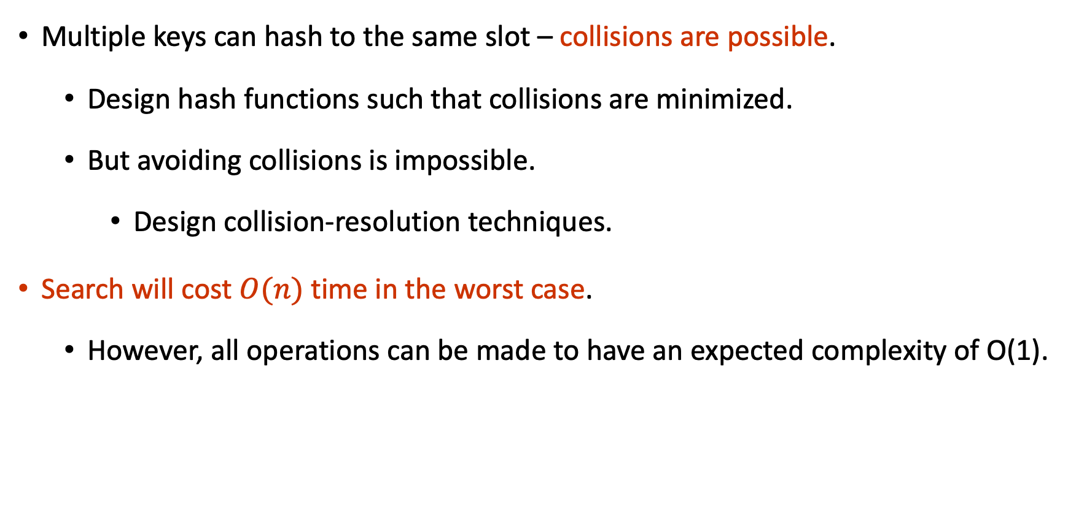
Issues with Hashing
Multiple keys can hash to the same slot – collisions are possible.
Design hash functions such that collisions are minimized.
But avoiding collisions is impossible.
Design collision-resolution techniques.
Search will cost $O(n)$ time in the worst case.
However, all operations can be made to have an expected complexity of O(1).

Slide 9
Methods of Resolution
Chaining:
Store all elements that hash to the same slot in a linked list.
Store a pointer to the head of the linked list in the hash table slot.
Open Addressing:
All elements stored in hash table itself.
When collisions occur, use a systematic (consistent) procedure to store elements in free slots of the table.
0
k₁
k₄
k₅
k₂
k₆
k₇
k₃
k₈
m–1

Slide 10
Collision Resolution by Chaining
0
U
(universe of keys)
h(k₁)=h(k₄)
X
k₁
k₄
K
(actual
keys)
k₂
k₆
X
h(k₂)=h(k₅)=h(k₆)
k₅
k₈
k₇
k₃
X
h(k₃)=h(k₇)
h(k₈)
m–1

Slide 11
Collision Resolution by Chaining
0
U
(universe of keys)
k₁
k₄
k₁
k₄
K
(actual
keys)
k₂
k₆
k₅
k₂
k₆
k₅
k₈
k₇
k₃
k₇
k₃
k₈
m–1

Slide 12

Good Hash Functions
Satisfy the assumption of simple uniform hashing.
Not possible to satisfy the assumption in practice.
Regularity in key distribution should not affect uniformity.
Hash value should be independent of any patterns that might exist in the data.
1 | 0.14
2 | 0.43
3 | 0.07
4 | 0.12
5 | 0.87
$$h\left(x\right) \sim U(0,1)$$

Slide 13
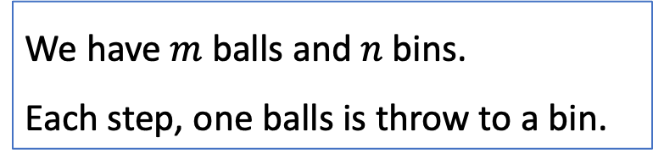

Collision Probability
Using hash-functions in streaming algorithms, require analysis of collisions.
For better story, we will use the problem:
Since we want to bound the probability, we may use Bernoulli’s inequality:
$$1+x≤e^{x}$$
We have $m$balls and $n$ bins.
Each step, one balls is throw to a bin.

Slide 14
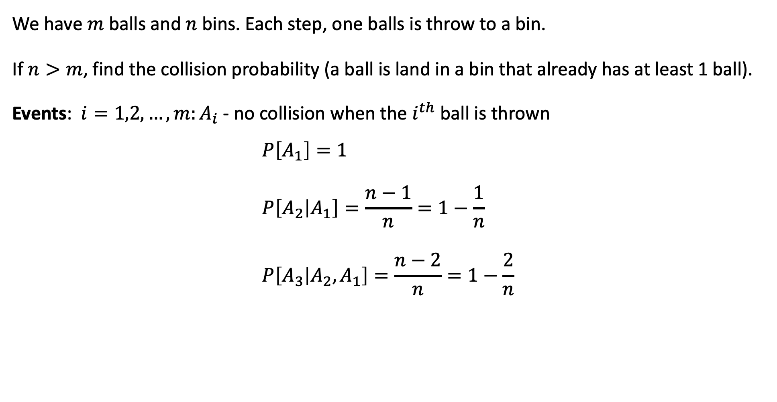
Collision Probability
We have $m$balls and $n$ bins. Each step, one balls is throw to a bin.
If $n>m$, find the collision probability (a ball is land in a bin that already has at least 1 ball).
Events: $i=1,2,…,m:A_{i}$ - no collision when the $i^{th}$ ball is thrown
$$P\left[A_{1}\right]=1 \\ P\left[A_{2} | A_{1}\right]=\frac{n−1}{n}=1−\frac{1}{n} \\ P\left[A_{3} | A_{2},A_{1}\right]=\frac{n−2}{n}=1−\frac{2}{n}$$

Slide 15
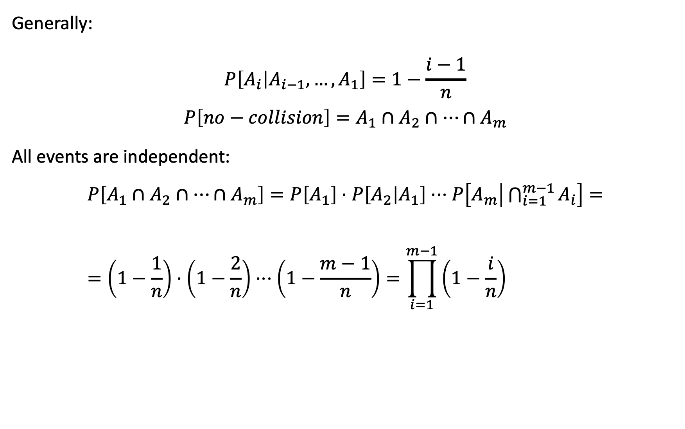
Generally: $$P\left[A_{i} | A_{i−1},…,A_{1}\right]=1−\frac{i−1}{n}$$
$$P\left[no−collision\right]=A_{1}∩A_{2}∩…∩A_{m}$$
All events are independent:
$$P\left[A_{1}∩A_{2}∩…∩A_{m}\right]=P\left[A_{1}\right]⋅P\left[A_{2} | A_{1}\right]⋅⋅⋅P\left[A_{m} | \bigcap_{i=1}^{m−1}{A_{i}}\right]==\left(1−\frac{1}{n}\right)⋅\left(1−\frac{2}{n}\right)⋅⋅⋅\left(1−\frac{m−1}{n}\right)=\prod_{i=1}^{m−1}{\left(1−\frac{i}{n}\right)}$$

Slide 16

Using $1+x≤e^{x}$ (Bernoulli’s inequality):
$$\left(1−\frac{1}{n}\right)≤e^{−\frac{1}{n}} \\ \left(1−\frac{2}{n}\right)≤e^{−\frac{2}{n}} \\ … \\ \left(1−\frac{m−1}{n}\right)≤e^{−\frac{m−1}{n}}$$
We get:
$$P\left[A_{1}∩A_{2}∩…∩A_{m}\right]=\left(1−\frac{1}{n}\right)⋅\left(1−\frac{2}{n}\right)⋅⋅⋅\left(1−\frac{m−1}{n}\right)≤ \\ e^{−\frac{1}{n}}⋅e^{−\frac{2}{n}}⋅⋅⋅e^{−\frac{m−1}{n}}=e^{−\frac{1}{n} − \frac{2}{n} −…−\frac{m−1}{n}}$$

Slide 17
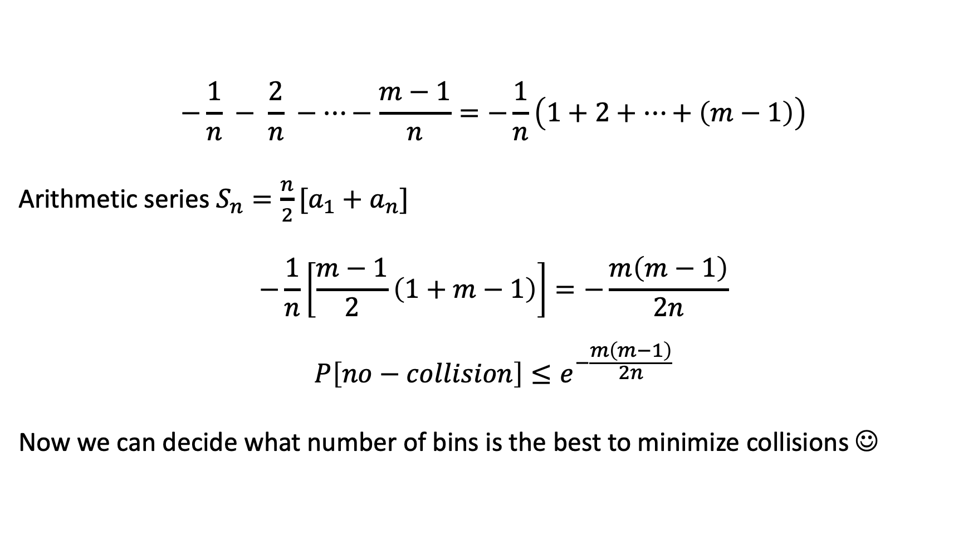
$$−\frac{1}{n} − \frac{2}{n} −…−\frac{m−1}{n}=−\frac{1}{n}\left(1+2+…+\left(m−1\right)\right)$$
Arithmetic series $S_{n}=\frac{n}{2}[a_{1}+a_{n}]$
$$−\frac{1}{n}\left[\frac{m−1}{2}\left(1+m−1\right)\right]=−\frac{m\left(m−1\right)}{2n}$$
$$P\left[no−collision\right]≤e^{−\frac{m\left(m−1\right)}{2n}}$$
Now we can decide what number of bins is the best to minimize collisions ☺

Slide 18


Upper Bound for Coin Flip
A fair coin is flipped $n$ times. For any $k>0,$ we want to find the upper bound on the probability that there is a sequence of $\log{n}+k$ consecutive heads.
H
T
H
T
H
H
H
H
…
$$n=8, logn=3, k=1, logn+k=4$$

Slide 19

Upper Bound for Coin Flip
Events: $h_{i}$ - the $i^{th}$ flip is head, for $i=1,2,…,n$,
$H_{i}$ - starting from the $i^{th}$ flip, we get $\log{n}+k$ heads
The samples of each $H_{i}$ can be 1 flip after the $i^{th}$ flip, 2 flips, …, $n−\log{n}−k+1$
$$n−\log{n}−k+1=8−3−1+1=5$$
H
T
H
T
H
H
H
H

Slide 20
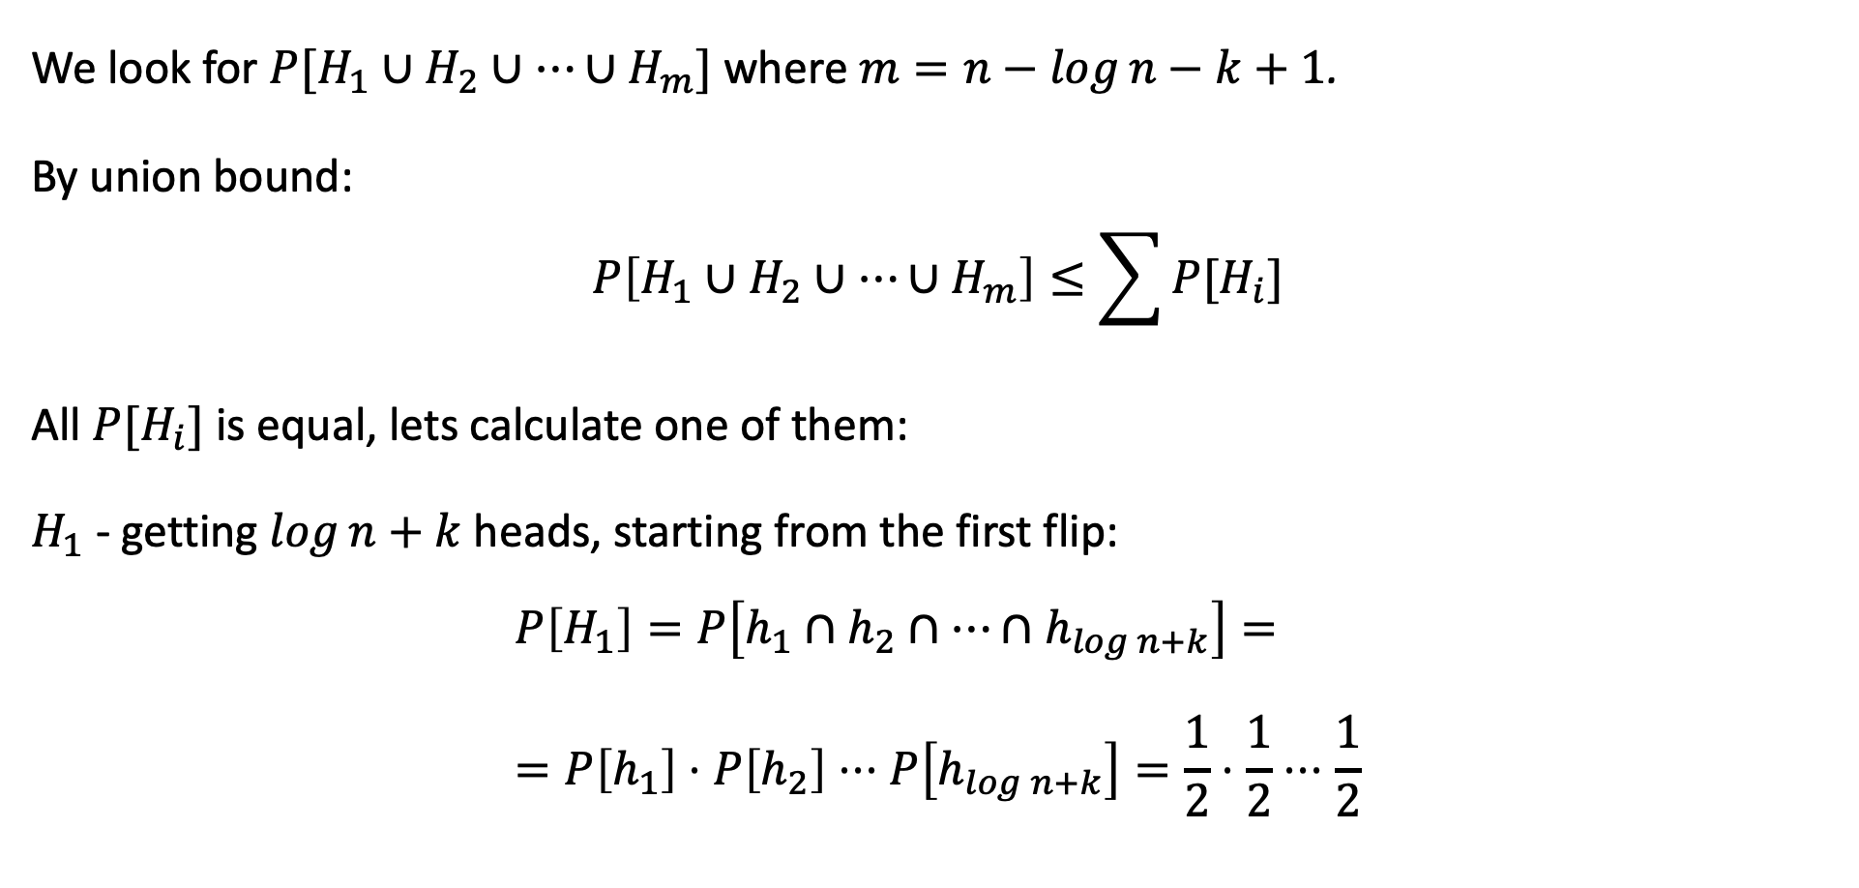
Upper Bound for Coin Flip
We look for $P[H_{1}∪H_{2}∪…∪H_{m}]$ where $m=n−\log{n}−k+1$.
By union bound:
$$P\left[H_{1}∪H_{2}∪…∪H_{m}\right]≤\sum{P[H_{i}]}$$
All $P[H_{i}]$ is equal, lets calculate one of them:
$H_{1}$ - getting $\log{n}+k$ heads, starting from the first flip:
$$P\left[H_{1}\right]=P\left[h_{1}∩h_{2}∩…∩h_{\log{n}+k}\right]= \\ =P\left[h_{1}\right]⋅P\left[h_{2}\right]⋅⋅⋅P\left[h_{\log{n}+k}\right]=\frac{1}{2}⋅\frac{1}{2}⋅⋅⋅\frac{1}{2}$$

Slide 21
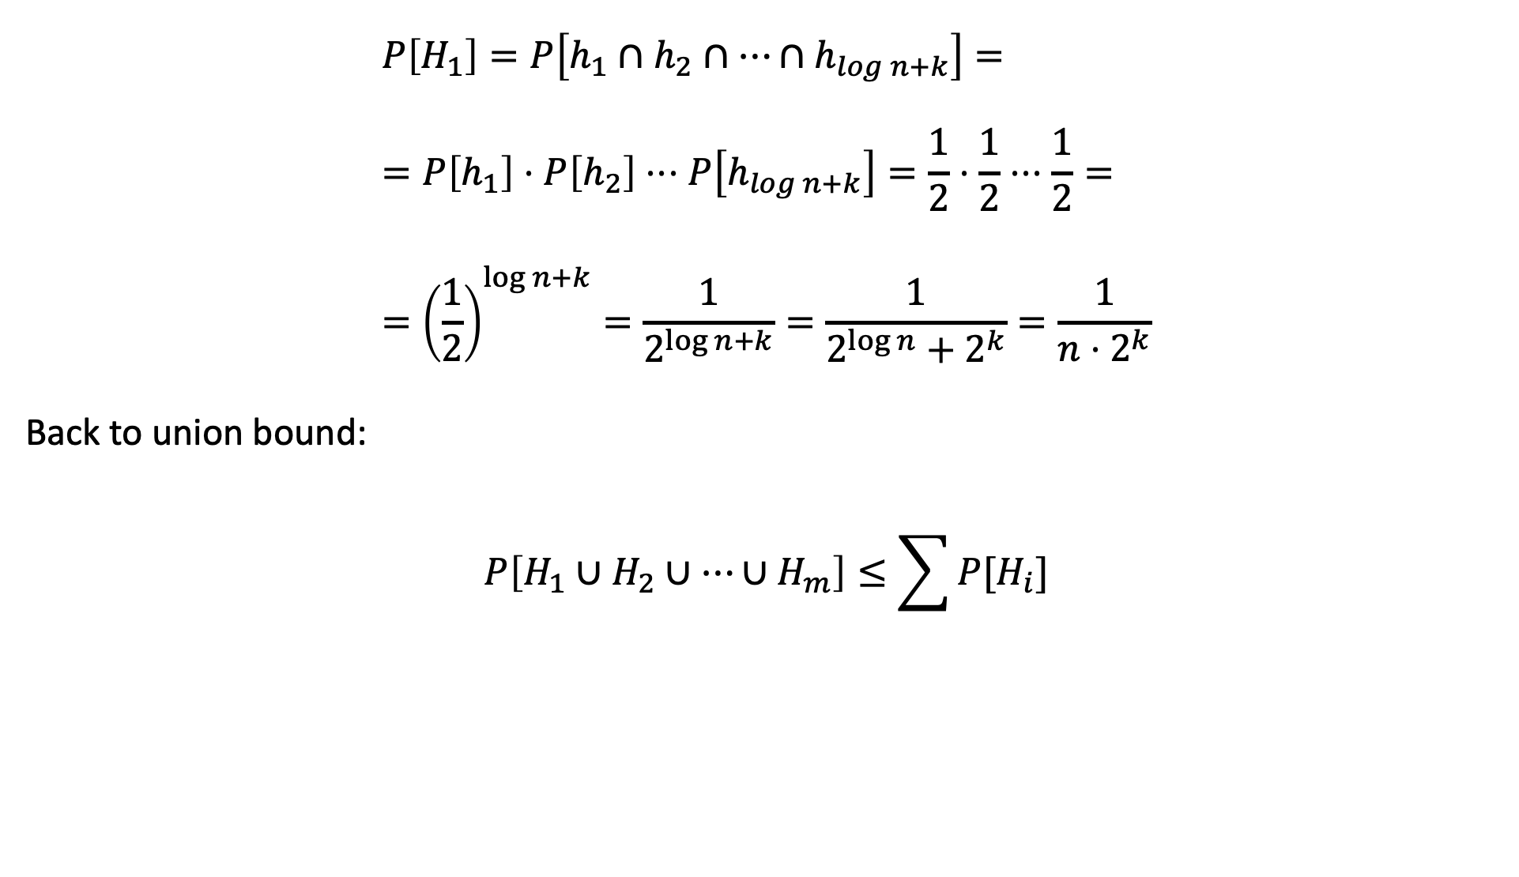
Upper Bound for Coin Flip
$$P\left[H_{1}\right]=P\left[h_{1}∩h_{2}∩…∩h_{\log{n}+k}\right]= \\ =P\left[h_{1}\right]⋅P\left[h_{2}\right]⋅⋅⋅P\left[h_{\log{n}+k}\right]=\frac{1}{2}⋅\frac{1}{2}⋅⋅⋅\frac{1}{2}= \\ ={\left(\frac{1}{2}\right)}^{\log{n}+k}=\frac{1}{2^{\log{n}+k}}=\frac{1}{2^{\log{n}}+2^{k}}=\frac{1}{n⋅2^{k}}$$
Back to union bound:
$$P\left[H_{1}∪H_{2}∪…∪H_{m}\right]≤\sum{P[H_{i}]}$$

Slide 22

Upper Bound for Coin Flip
The samples of each $H_{i}$ can be 1 flip after the $i^{th}$ flip, 2 flips, …, $n−\log{n}−k+1$
$$P\left[H_{1}∪H_{2}∪…∪H_{m}\right]≤\sum{P\left[H_{i}\right]}=\sum_{i=1}^{n−\log{n}−k+1}{\frac{1}{n⋅2^{k}}}= \\ =\frac{n−\log{n}−k+1}{n⋅2^{k}}≤\frac{n}{n⋅2^{k}}=\frac{1}{2^{k}}$$

Slide 23
Approximation and Randomization
Many things are hard to compute exactly over a stream
Is the count of all items the same in two different streams?
Approximation: find an answer correct within some factor
”Find an answer that is within 10% of correct result”
Randomization: allow a small probability of failure
“Answer is correct, except with probability 1 in 10,000”

Slide 24
Approximation and Randomization
More generally,
Approximation: find an answer correct within a (1± ε) factor approximation
Randomization: allow a small probability of failure / success probability (1-δ)
Here we want to develop Approximation and Randomization algorithms,
called (ε, δ)-approximations.

Slide 25
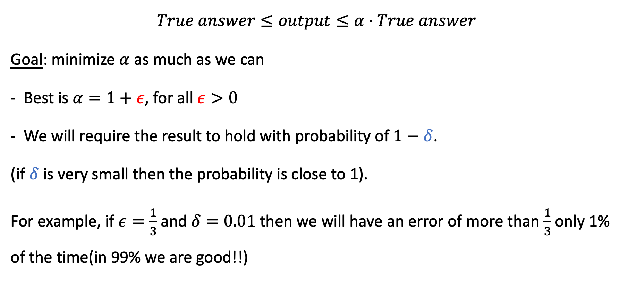
Approximation
$$True answer≤output≤α⋅True answer$$
Goal: minimize $α$ as much as we can
Best is $α=1+ε$, for all $ε>0$
We will require the result to hold with probability of $1−δ$.
(if $δ$ is very small then the probability is close to 1).
For example, if $ε=\frac{1}{3}$ and $δ=0.01$ then we will have an error of more than $\frac{1}{3}$ only 1% of the time(in 99% we are good!!)

